Slide 1
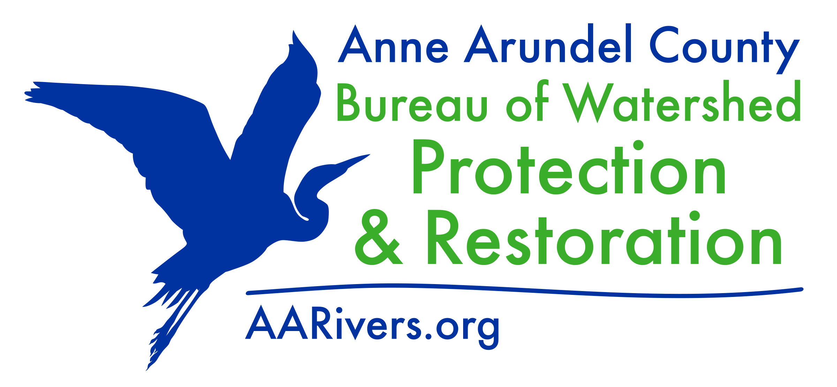
BEAVER CREEK RESTORATION UPDATE
CROFTON CIVIC ASSOCIATION
August 27, 2025

Slide 2
Topics to be addressed
Would like concrete evidence and details on additional plantings on Route 3 side.
Additional concerns on scope of work and the negative impact of tree clearing - are there any alternatives beyond what was designed and proposed to Crofton Civic Association?
Is there a less invasive design? There has been significant erosion as a result of restoration work along Crofton Tributary, which the County has had to repair.
Can less tree clearing occur?
Are additional restoration measures taken on the downstream side of Route 3? Can the work take place there on County property instead of this location?
Are there any data acquired from the Phase 1 restoration showing improvements as a result of construction?

Slide 3
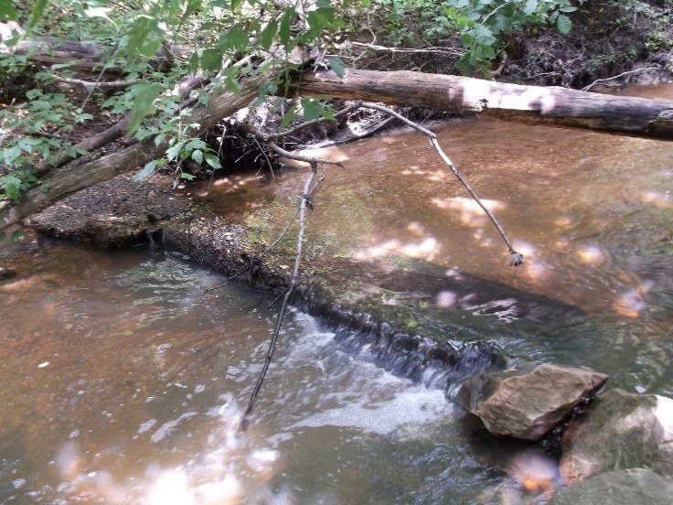
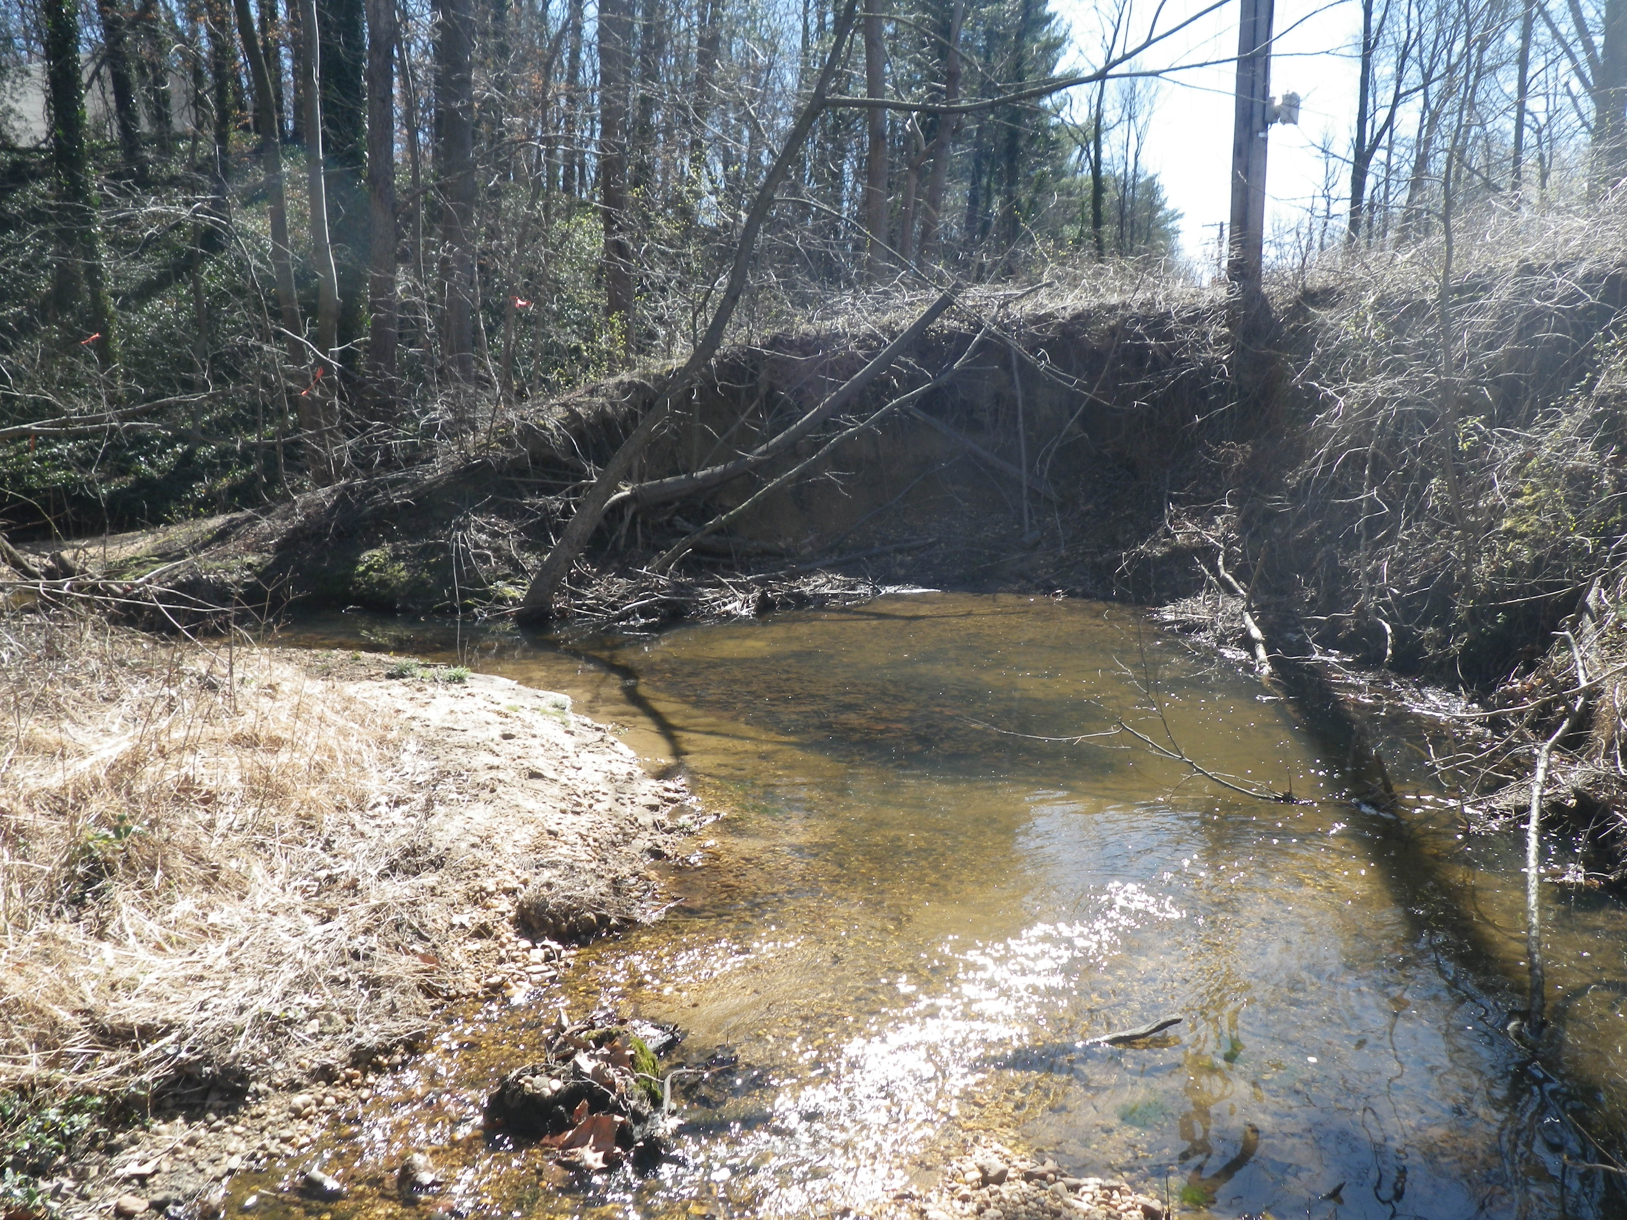
Existing Conditions
Exposed sewer infrastructure
Eroding Bank – Overhead electric pole

Slide 4
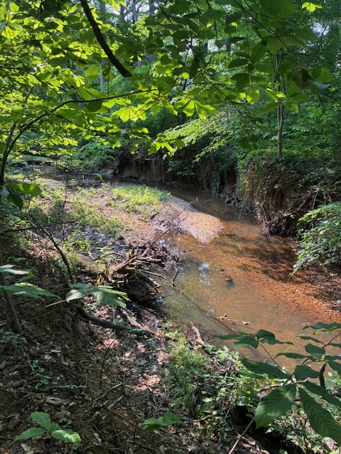
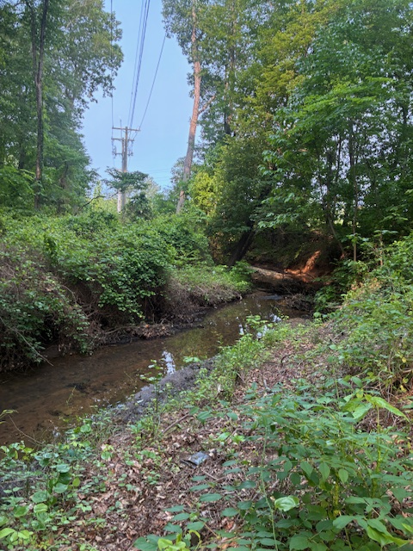
Existing Conditions
Bank erosion
Bank erosion

Slide 5
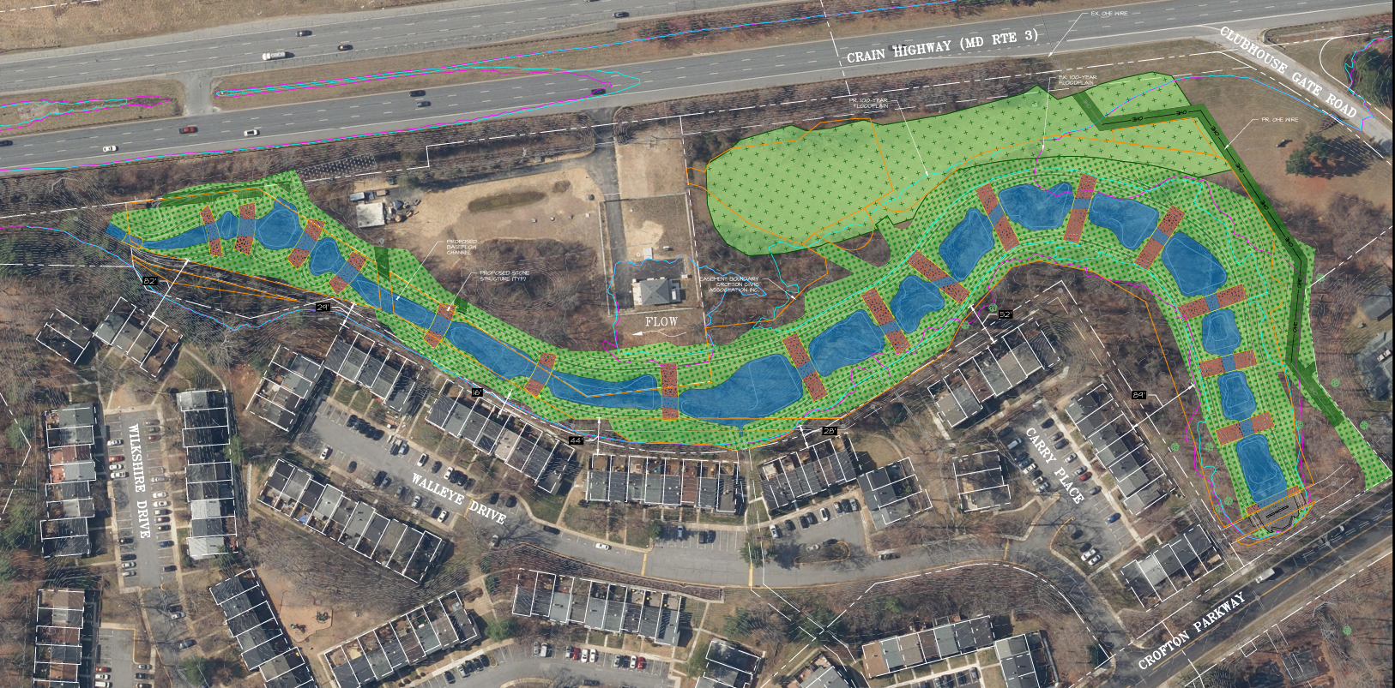
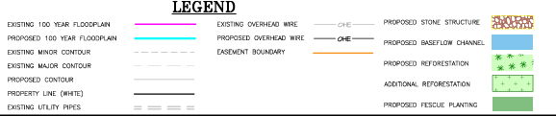
Plantings and Plan Overview

Slide 6
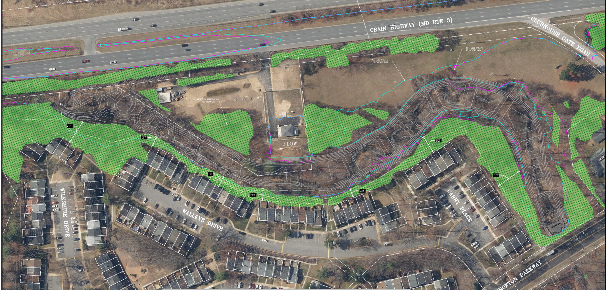
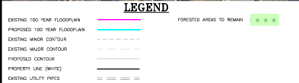
Tree Retention Areas

Slide 7
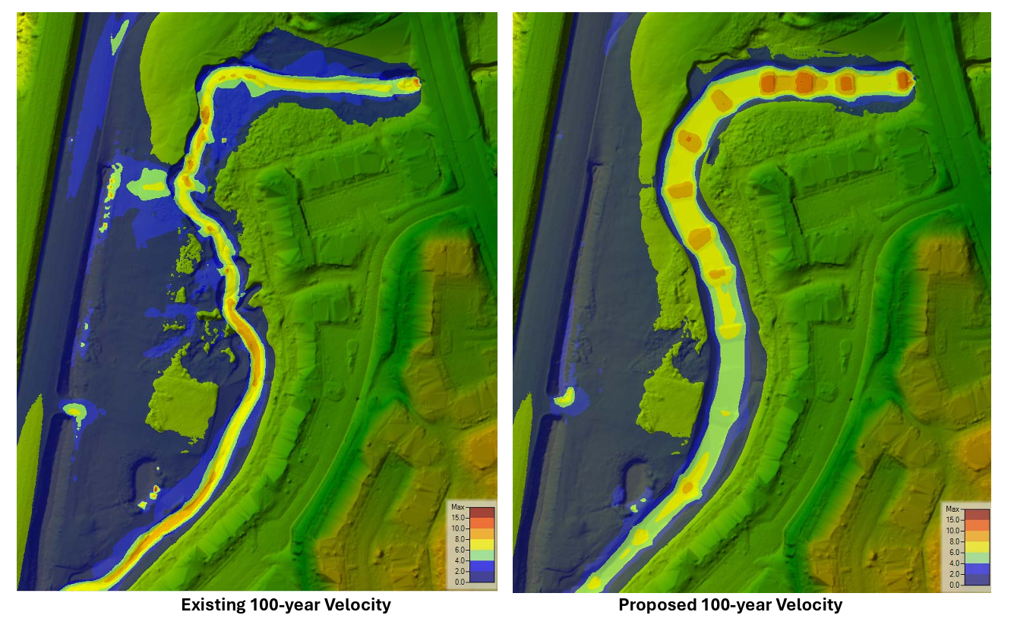
Are there Alternatives? 2D Model Results

Slide 8
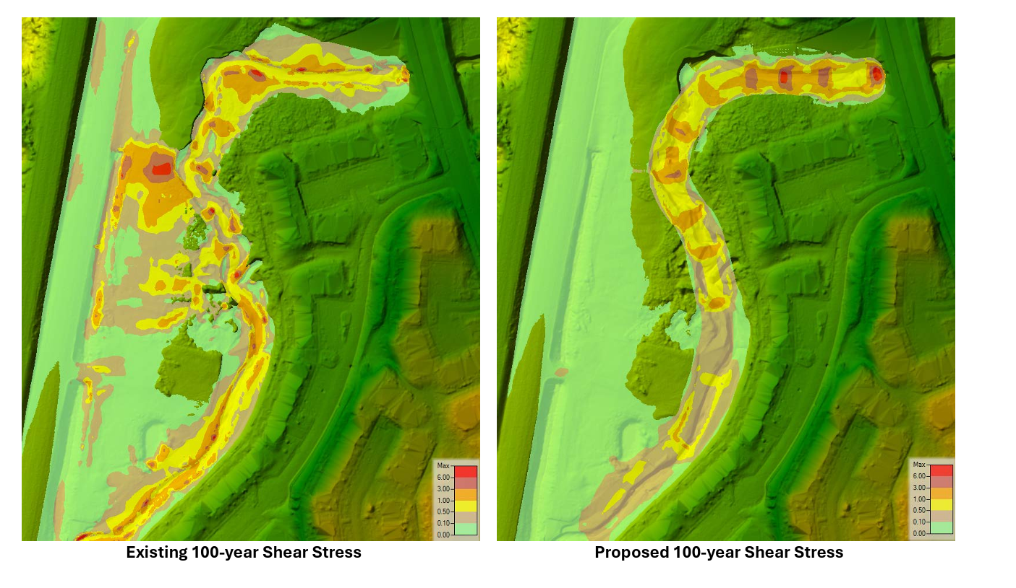
Are there Alternatives? 2D Model Results

Slide 9
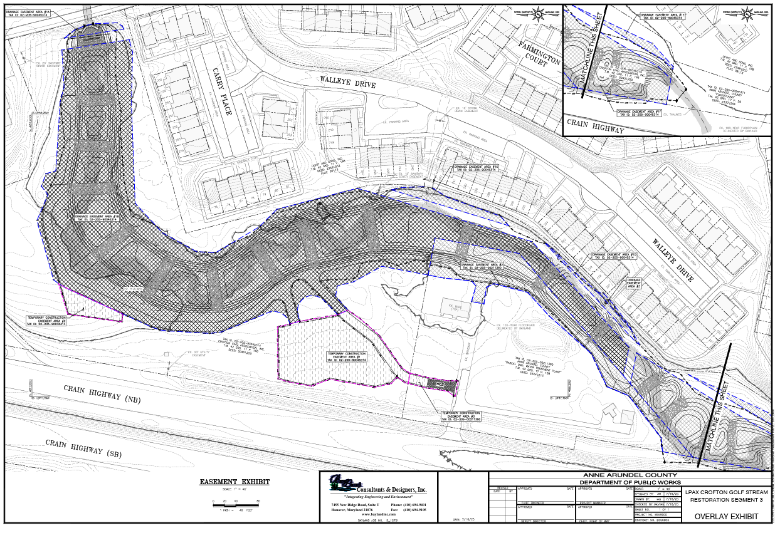
Easement location (floodplain and access – Revised)

Slide 10
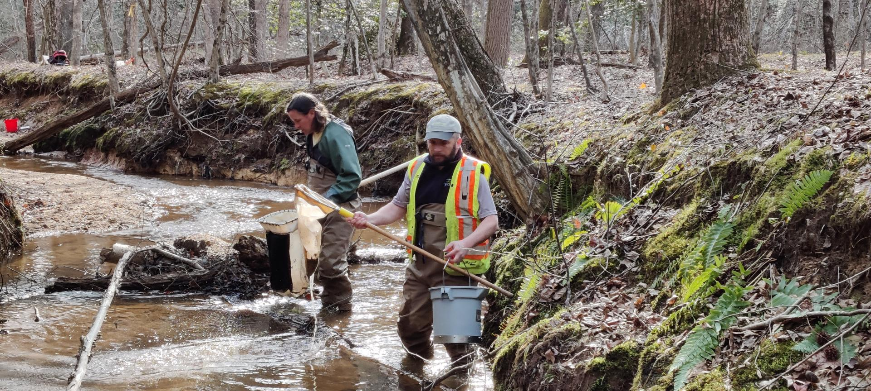
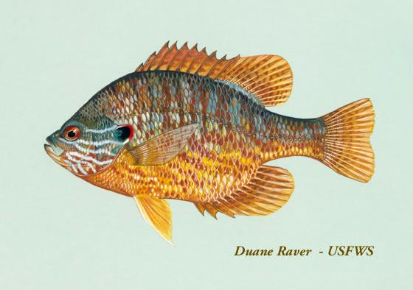
Results from a Similar Restoration Site
Mill Creek Observations in 2022:
MC-01: Located in the restoration project
Species observed:
Brown Bullhead
American Eel
Pumpkinseed
Mummichog
Golden Shiner
Eastern Mudminnow
Banded Killifish
Spottail Shiner
Eastern Mosquitofish
Chain Pickerel
FIBI = 3.33
MC-01 Fish Index of Biotic Integrity (FIBI) SCORES
2020 - 3.00 (Fair) with 9 species observed
2018 - 2.33 (Poor)
2016 - 2.67 (Poor)
2015 - 3.00 (Fair)
Data not typically collected in year 1, sites are selected – similar restored site results

Slide 11
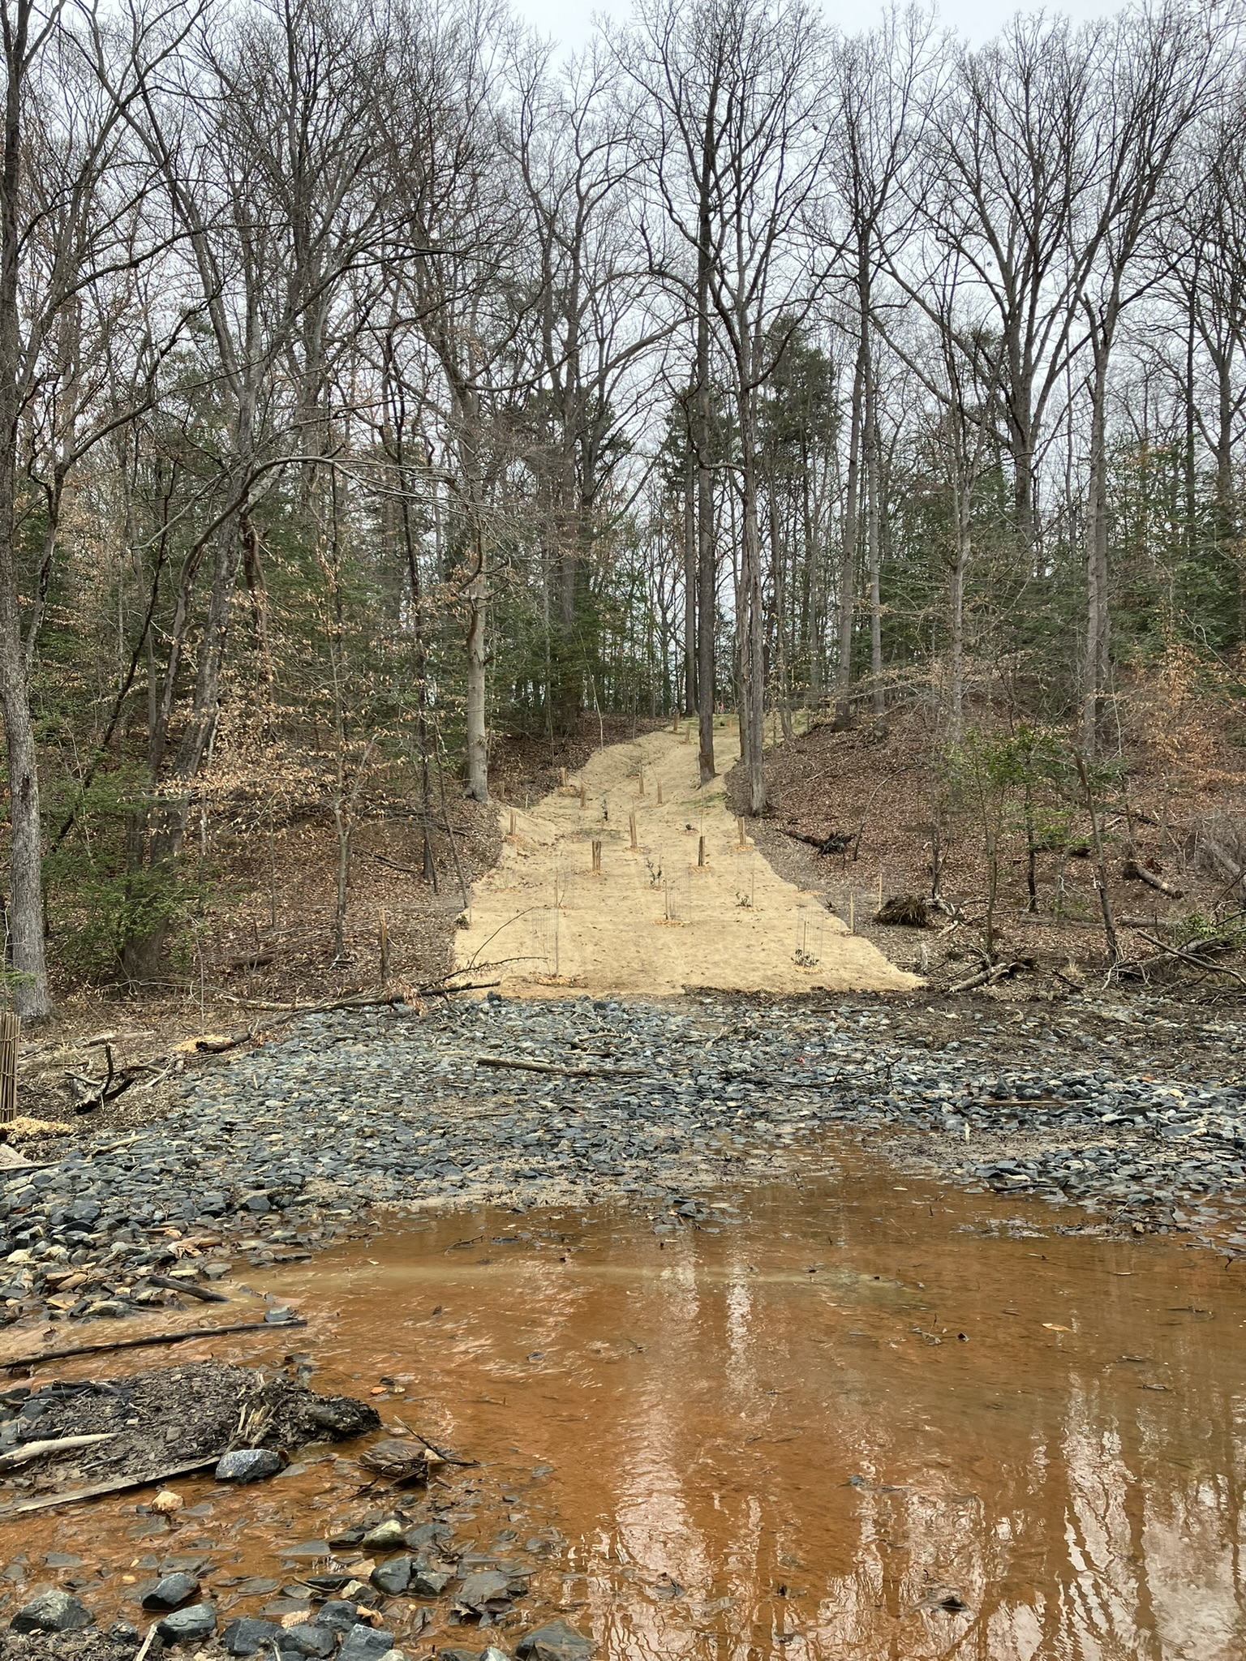
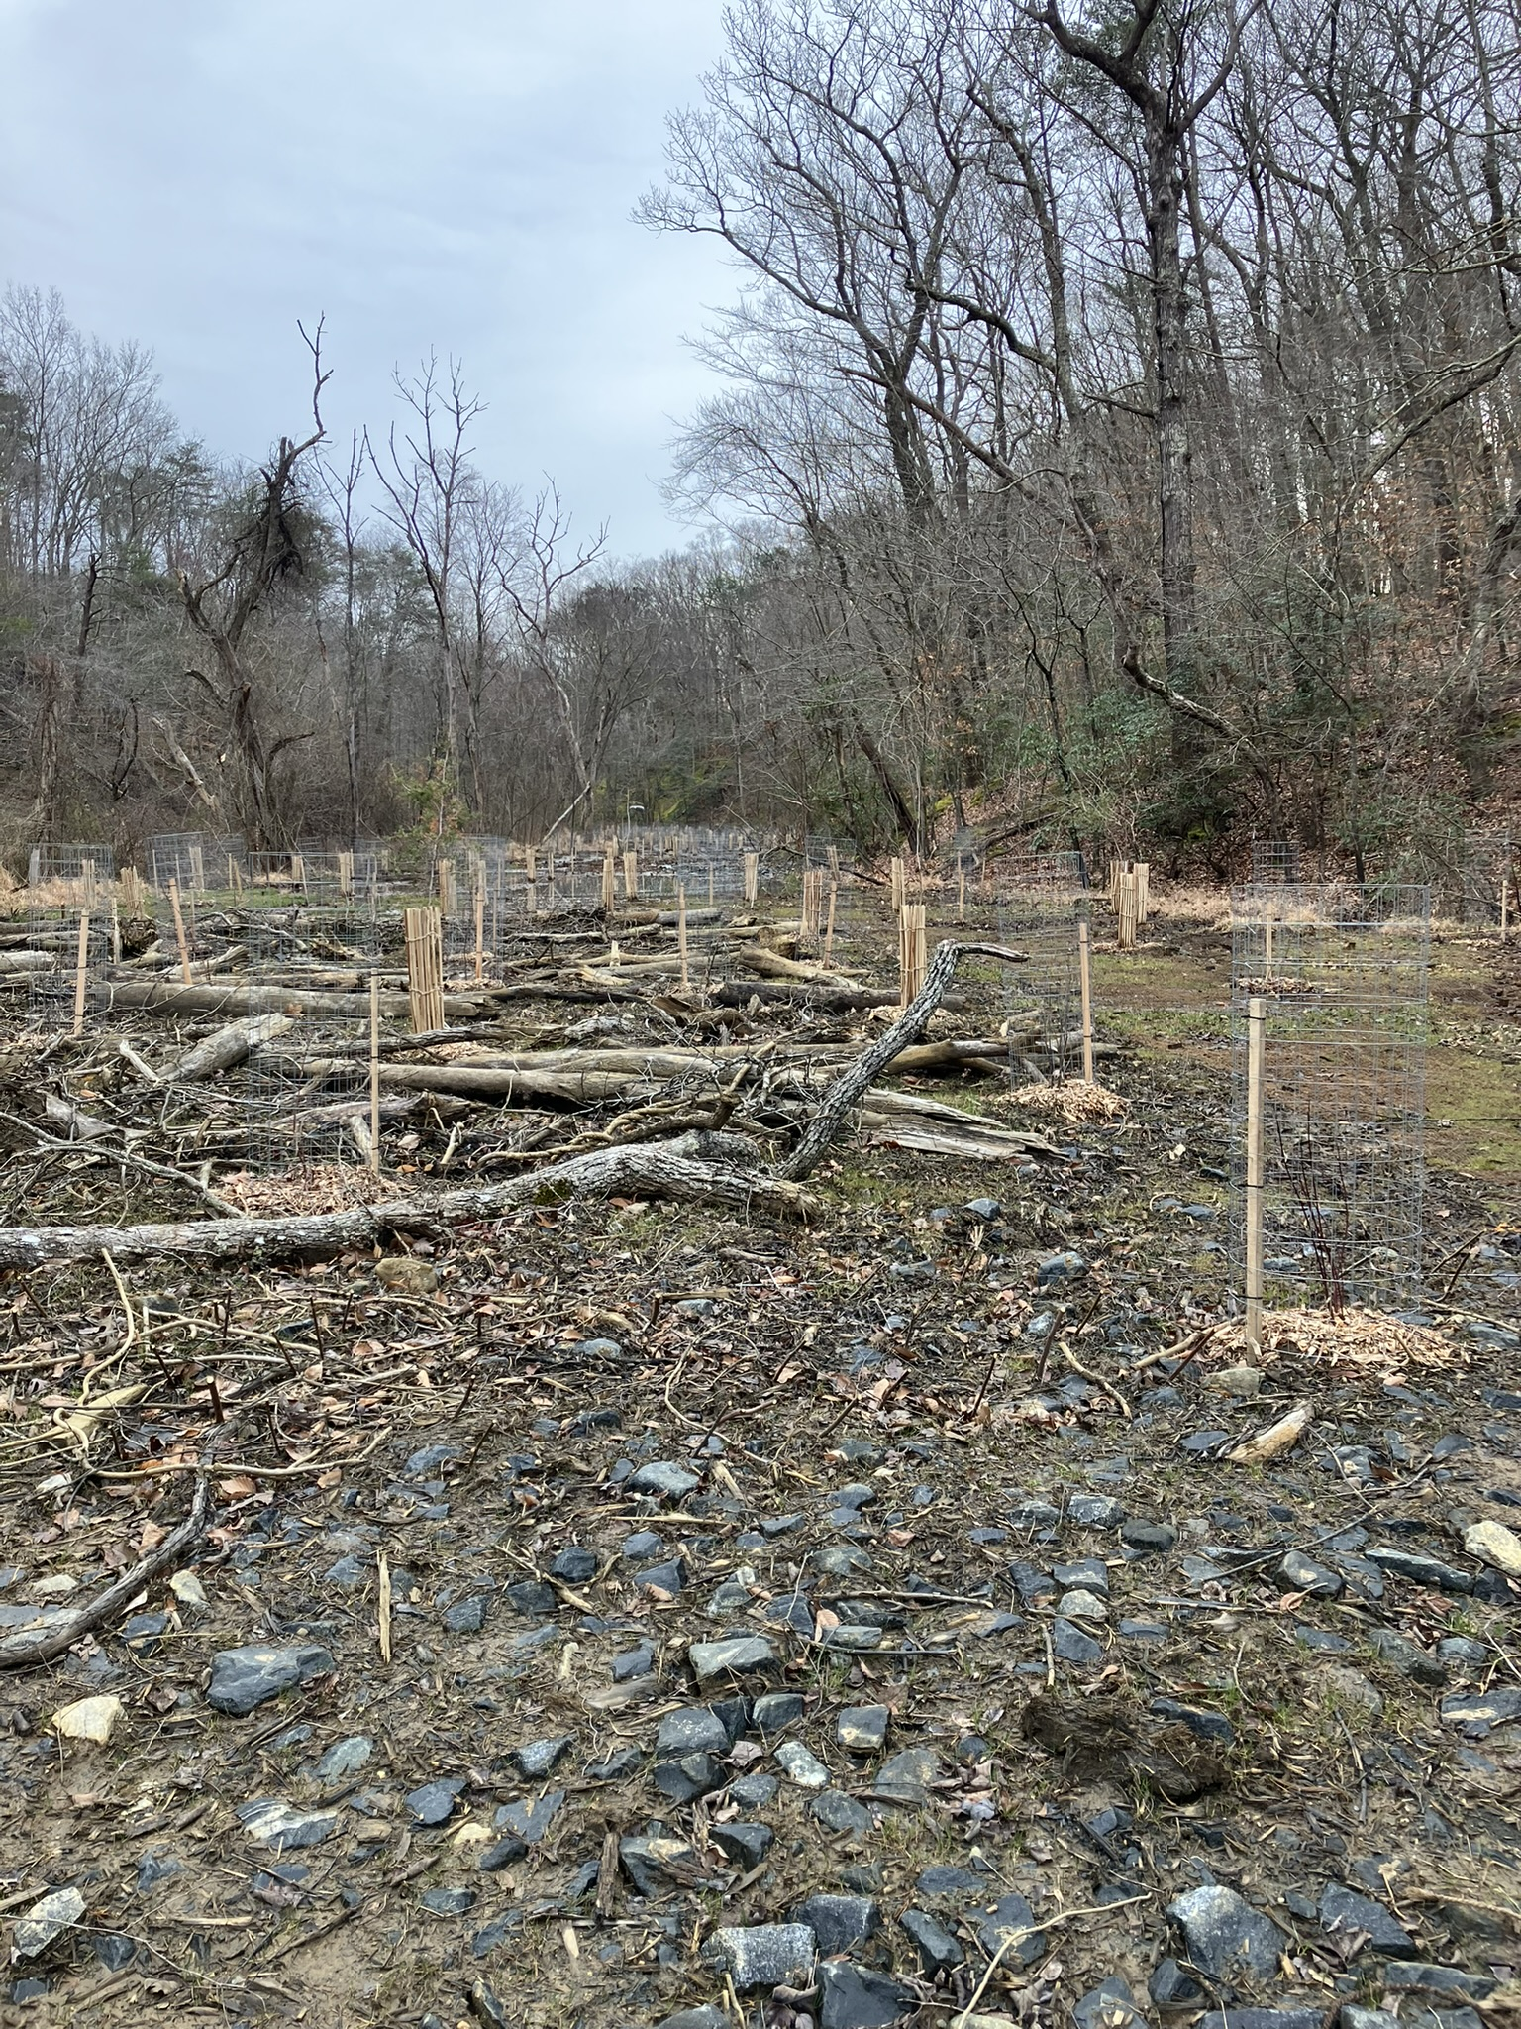
Broad Creek– During /after construction
Entrance and grade control structure
View from valley wide structure

Slide 12
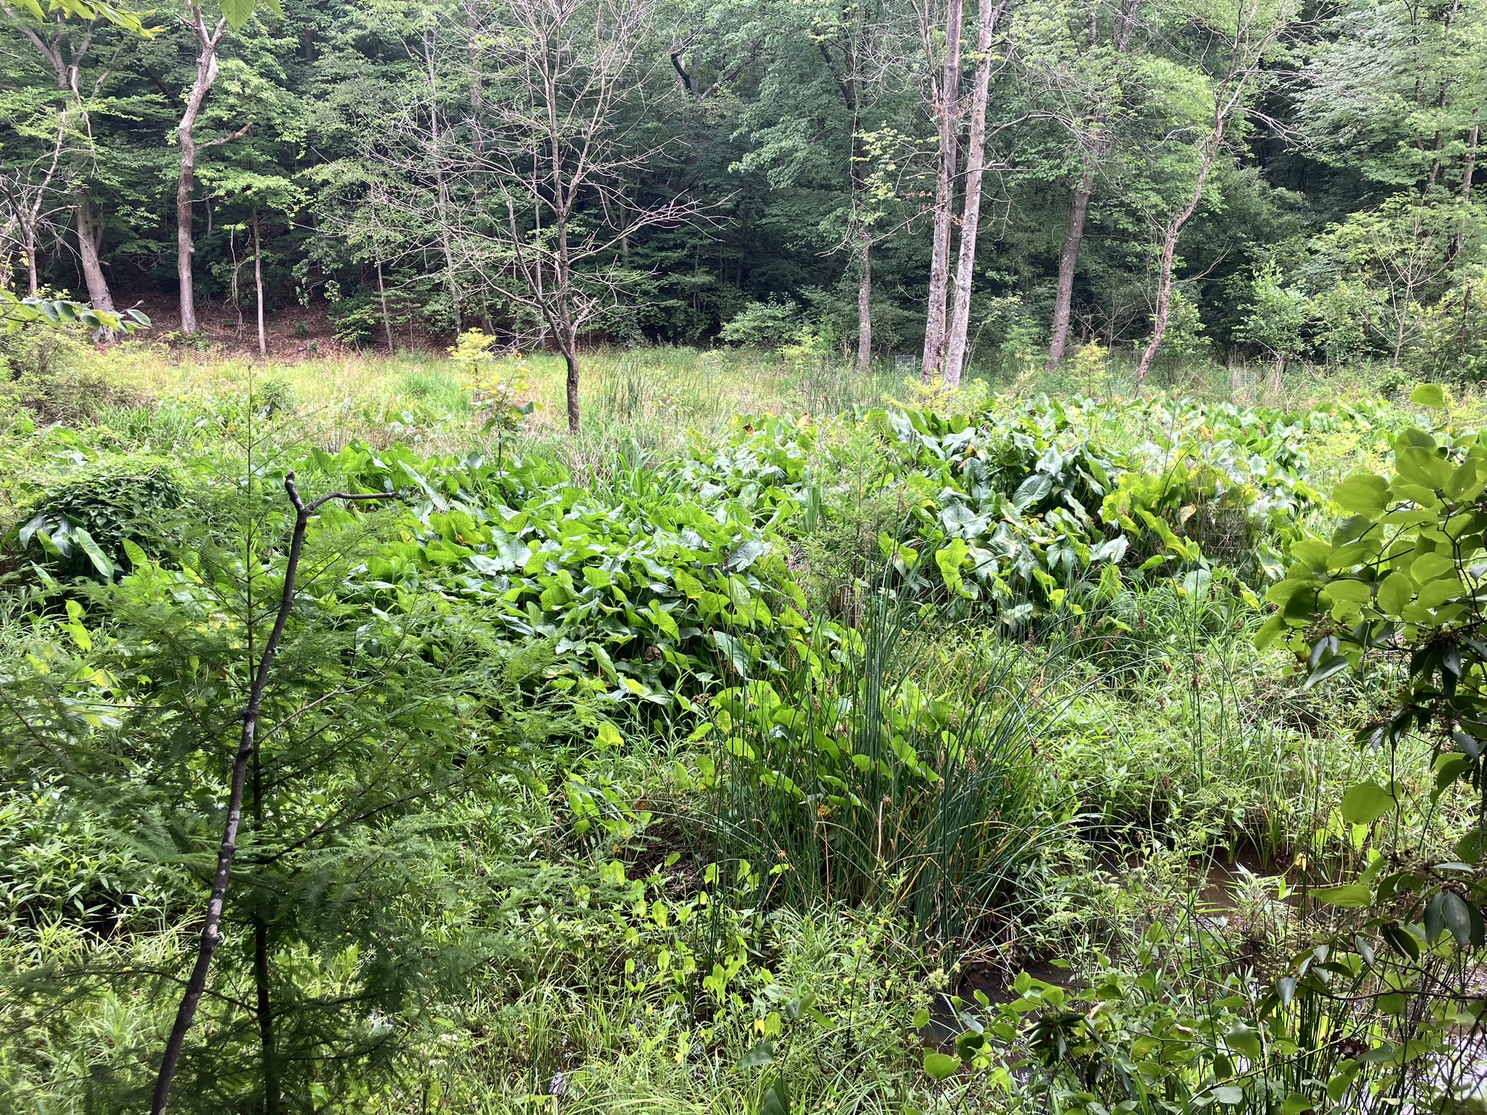
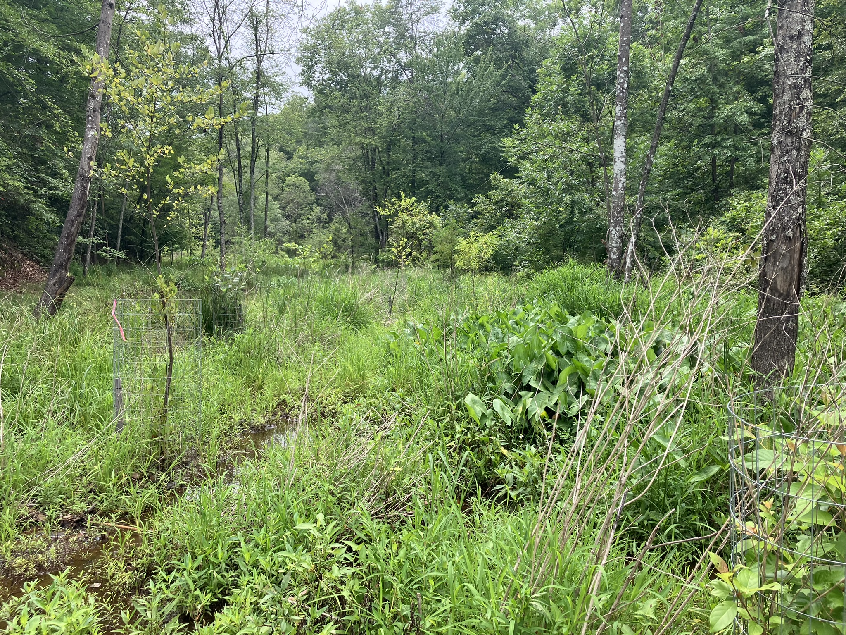
Broad Creek– Post restoration
Post –Restoration After 1 growing season
Post –Restoration After 1 growing season

Slide 13
Project Timeline - Phase 2
Design has been completed
Floodplain Easements Crofton Civic Association
Ongoing Coordination with BGE for Pole access and relocation
Submit for State and Federal Permits - June 2025
Submit for County Grading Permit – June 2025
Contractor Bid & Award – 6 months duration – est January 2026
Construction duration BGE pole relocation – 6 months
Construction duration expected – 4 months – est- July 2026
Additional mailings will be sent to residents as construction gets closer

Slide 14
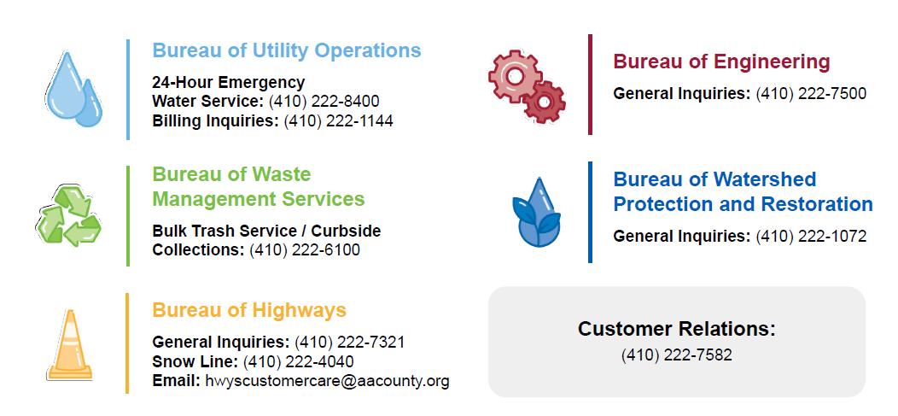

www.facebook.com/annearundeldpw
@AACoDPW

Slide 15

Questions and Discussion
Nasrin M. Dahlgren
Senior Project Manager
Watershed Protection and Restoration Program
Anne Arundel County Department of Public Works
2662 Riva Road, MS-7217
Annapolis, MD 21401
(410) 222-4824
pwdahl39@aacounty.org
www.aarivers.org

